Slide 1
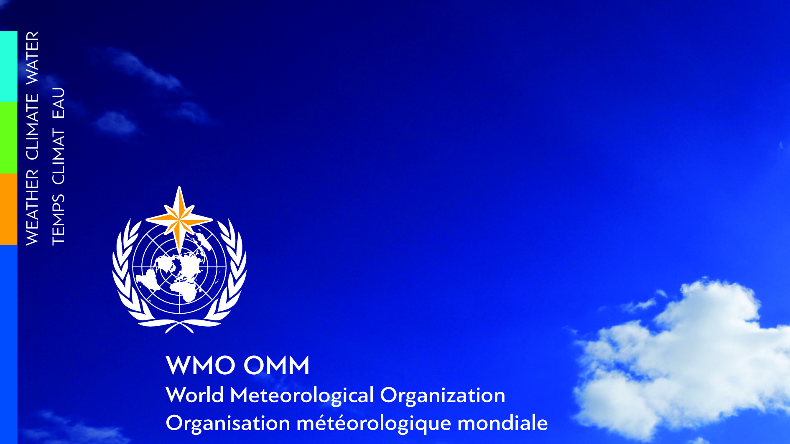
WMO Hydrological Observing System (WHOS)
Silvano Pecora
Vice-president of the Commission for Observation, Infrastructure and Information Systems (Infrastructure Commission)
Juan Bianchi
National Water Institute (Argentina)

Slide 2
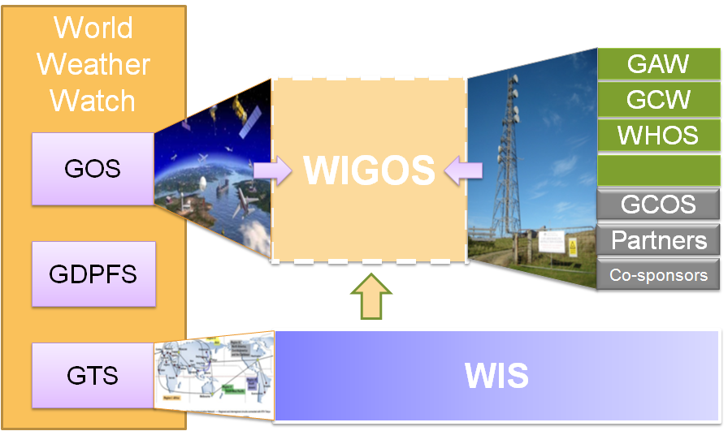
WHOS as hydrological contribution to
WMO Information System (WIS)/WMO Integrated Global Observing System (WIGOS)
In June 2015, the President of CHy informed Cg-17 of CHy proposal to develop WHOS as the CHy contribution to WIGOS
  Congress welcomed the effort and urged the president of CHy to continue guiding WHOS to full implementation
  Congress urged the promotion of WHOS among NHSs and the hydrological community
In June 2018, Executive Council endorsed the initial Implementation Plan for WHOS Phase II
WHOS Phase II:
A fully WIS/WIGOS compliant services-oriented framework linking hydrologic data providers and users through a hydrologic information system enabling data registration, data discovery, and data access.

Slide 3





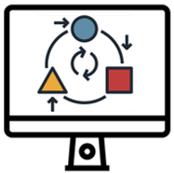
Standardization and brokering approaches
WMO Hydrological Observing System (WHOS)
Standardization approach
is key in making data more findable, accessible, interoperable and reusable
compatible
and complementary
Brokering approach
addresses technological, data and format layers of interoperability

Slide 4
Standardization approach
Through joint activities of WMO and Open Geospatial Consortium (OGC), WaterML 2.0 standard had been developed and its following parts have been approved by OGC and WMO through WMO Resolutions:
Part 1 - Time Series;
Part 2 - Ratings, Gaugings and Sections;
Part 3 - Surface Hydrology Features (approved only by OGC);
Part 4 - Groundwater Features.
Part under development:
WaterML-WQ – an O&M and WaterML 2.0 profile for water quality data.
In real world, the standardization approach alone is not sufficient, because in many cases a single country does not have the possibility (e.g. limited resources) or willingness to implement a specific standard for their NHS.

Slide 5












DATA PROVIDERS and WEB SERVICES
Interoperability burden
represents a huge effort for all participants!
DATA USERS and TOOLS
non-standardized
A
standardized
B
!
standardized
C
standardized
D
standardized
...

Slide 6

DATA PROVIDERS and WEB SERVICES
DATA USERS and TOOLS
Interoperability burden
is managed by broker!
non-standardized
A
standardized
B
standardized
C
standardized
Broker
D
standardized
...

Slide 7
Project objectives
Provide the most comprehensive hydrological component in fulfillment of the WIGOS objective of “an integrated, comprehensive, and coordinated system which is comprised of the present WMO global observing systems”
Provide contribution to the definition and implementation of WIS 2.0, as a collaborative system of systems using web-architecture and open standards to provide simple, timely and seamless sharing of trusted weather, water and climate data
Support NMHSs in publication of hydrological data on the Internet via web services
Advance Discovery and Access Broker (DAB) technology for hydrological metadata, data and web services harmonization using standardized web services and data formats, such as those stemming from the WMO, ISO and OGC
Facilitate discovery, access and use of real-time and historical hydrological data that are freely and openly published by heterogeneous data providers
Promote the reuse of shared data

Slide 8
Project team
Silvano Pecora (Italy)
Vice-president of the WMO Infrastructure Commission
Juan Bianchi (Argentina)
National Water Institute
Marcelo Jorge Medeiros (Brazil)
National Water Agency
Andy Wood (United States of America)
National Center For Atmospheric Research
Artem Shevchenko (Russian Federation)
Federal Service for Hydrometeorology and Environmental Monitoring

Slide 9
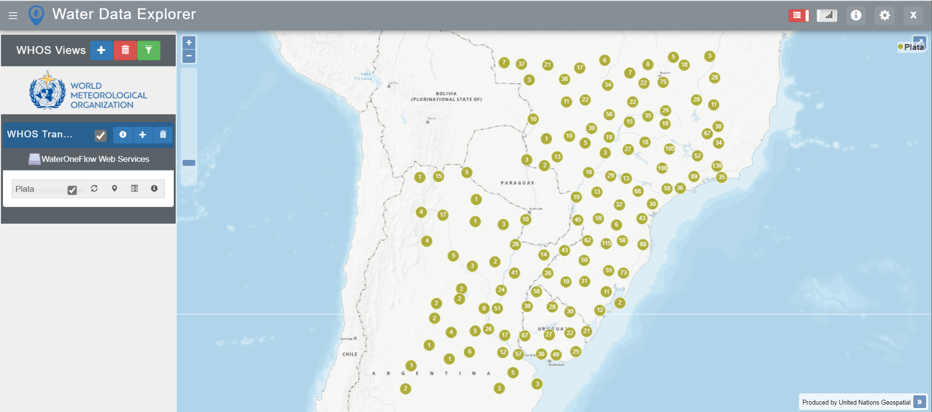
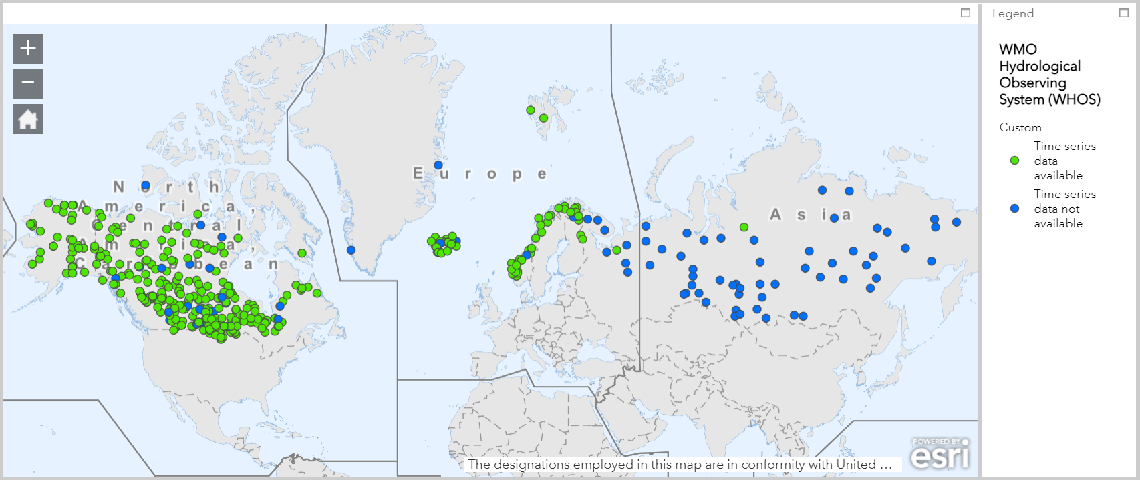
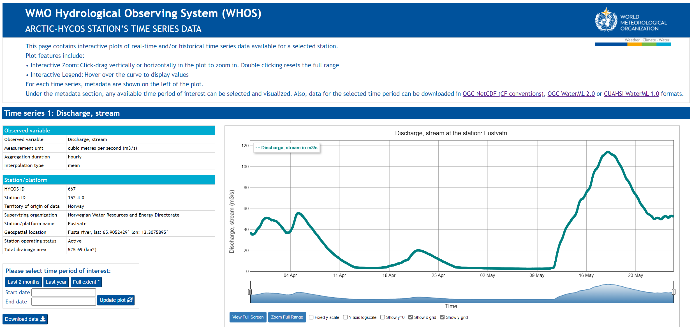
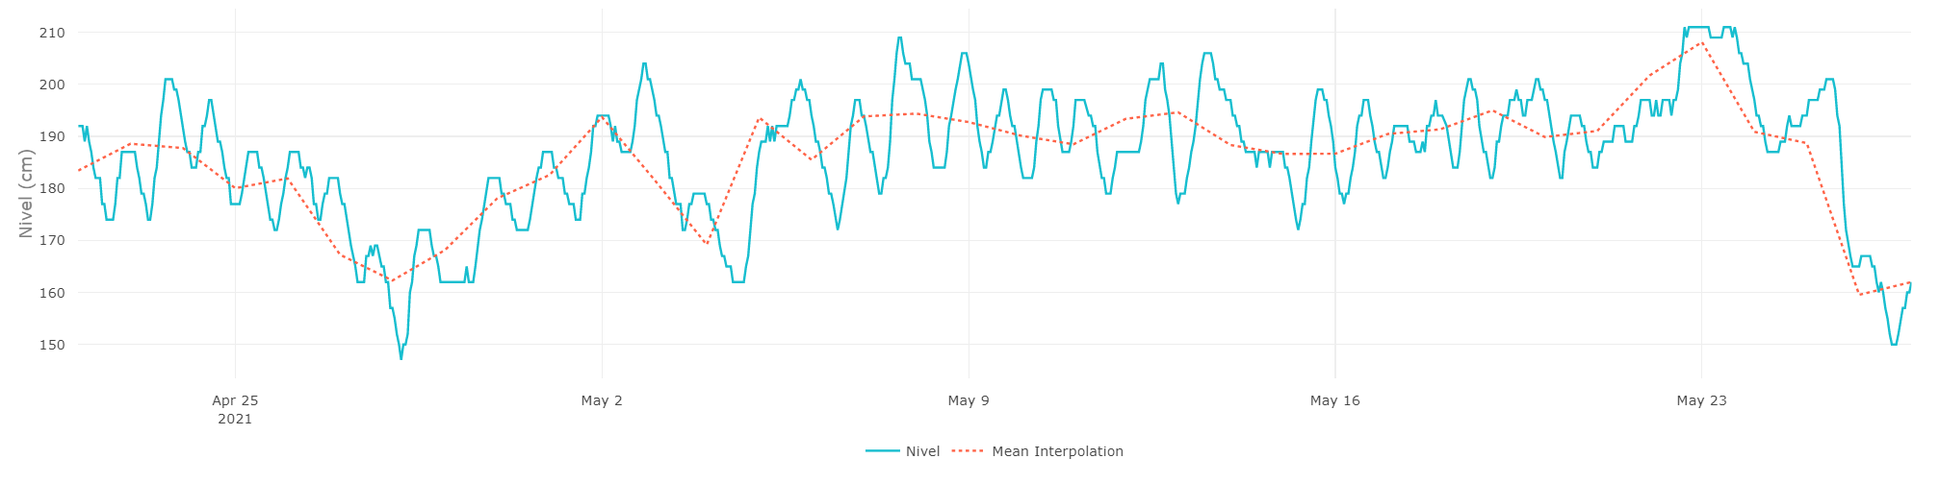
WHOS implementation in the La Plata and Arctic basins
WHOS-Plata
WHOS-Arctic

Slide 10
WHOS implementation in the Arctic basin
Arctic-HYCOS Project Steering Committee Members
Canada
Dr. Alain Pietroniro
Finland
Dr. Johanna Korhonen
Iceland
Dr. Jórunn Harðardóttir
Norway
Dr. Hege Hisdal
Russian Federation
Prof. Valery Vuglinsky
Sweden
Dr. David Gustafsson
United States of America
Mr. Jeff Conaway

Slide 11
WHOS implementation in the La Plata basin
Regional WHOS Broker Administration
(GISC, INMET)
Mr José Mauro de Rezende
Argentina
Dr. Leandro Giordano
Dra. Lorena Ferreira
Bolivia
Ing. Hugo Cutile Copa
Met. Marisol Lucia Portugal Alvarez
Brazil
Mr. Vinícius Roman
Ms. Juliana Maria Duarte Mol
Paraguay
Lic. Alejandro Pasten
Lic. Eduardo Mingo
Uruguay
MSc. Ing. Silvana Alcoz
Mr. Nestor Santayana

Slide 12
Project plan
Timeline | Projects | Normative | Communication | Training
2021 Cg-2021 EC-73 | Continued WHOS pilot projects Launch national WHOS projects Launch WHOS community page and portals | WHOS Phase II operational plan | Engagement with RA Survey available data sources and brokering needs WHOS Webinar | Workshop for SC-IMT Training plans for RA
2022 INFCOM EC-74 | Continued WHOS pilot projects (e.g., CREWS Cambodia and Laos) | WHOS Phase II draft architecture | Communication plan for WHOS Phase II implementation published to Members | WHOS Phase II training in RA
2023 Cg-19 EC-75 | Pilot projects final report | WHOS Phase II recommendations compliant with WIS 2.0 guidelines | WHOS Phase II recommendations and guidelines published to Members | Continued training in RA

Slide 13
WIS 2 Principles in the project
Principle 1: WIS 2.0 adopts Web technologies and leverages industry best practices and open standards
  WHOS supports various service interfaces and Application Programming Interfaces (APIs) that various data providers and user application builders can already leverage (e.g., OGC SOS, OGC CSW, OGC WMS, ESRI Feature Service, CUAHSI WaterOneFlow, DAB API, USGS RDB, OAI-PMH/WIGOS, THREDDS)
  New API and service protocols are continuously added to support new data providers web services and user applications with the aim of improving its interoperability. This is due to the WHOS-Broker being a modular and flexible framework designed considering the change/evolution of standards through time

Slide 14
WIS 2 Principles in the project
Principle 2: WIS 2.0 uses Uniform Resource Locators (URL) to identify resources
  WHOS makes use of URLs to identify resources such as datasets, sites, concepts from ontologies, through several of its published service interfaces

Slide 15
WIS 2 Principles in the project
Principle 3: WIS 2.0 prioritizes use of public telecommunications networks (i.e., Internet) when publishing digital resources
  WHOS supports publishing of metadata and data on Internet through various web services available for machine-to-machine access
  WHOS supports harvesting of digital data and metadata resources from various data providers that publish their resources on Internet through web services

Slide 16
WIS 2 Principles in the project
Principle 4: WIS 2.0 requires provision of Web service(s) to access or interact with digital resources (e.g., data, information, products) published using WIS
  WHOS-broker provides various standard web service interfaces and APIs (e.g., OGC SOS, OGC CSW, OGC WMS, ESRI Feature Service, CUAHSI WaterOneFlow, DAB API, USGS RDB, OAI-PMH/WIGOS, THREDDS)
  New APIs and service protocols are continuously added to support new applications

Slide 17
WIS 2 Principles in the project
Principle 5: WIS 2.0 encourages NCs and DCPCs to provide 'data reduction' services via WIS that process 'big data' to create results or products that are small enough to be conveniently downloaded and used by those with minimal technical infrastructure
  WHOS publishes data access interfaces supporting (1) subset functionality to retrieve only the data subsets that are of interest to the users (e.g., subset by temporal and spatial extent) and (2) down-sampling functionality to reduce the data size

Slide 18
WIS 2 Principles in the project
Principle 6: WIS 2.0 will add open standard messaging protocols that use the publish-subscribe message pattern to the list of data exchange mechanisms approved for use within WIS and GTS
  WHOS already supports publication of web services implementing publish-subscribe message pattern such as OGC Publish/Subscribe interface standard

Slide 19
WIS 2 Principles in the project
Principle 7: WIS 2.0 will require all services that provide real-time distribution of messages to cache/store the messages for a minimum of 24-hours, and allow users to request cached messages for download
  WHOS supports such requirements through its Data Cube component that acts as cache/store mechanism (component planned to be released by 2022)

Slide 20
WIS 2 Principles in the project
Principle 8: WIS 2.0 will adopt direct data exchange between provider and consumer
  WHOS-Broker works as a mediator between provider’s service and consumer’s application, suitably transforming the data on-the-fly and without storing any data (except for caching purposes)

Slide 21
WIS 2 Principles in the project
Principle 9: WIS 2.0 will phase out the use of routing tables and bulletin headers
  WHOS can support publication of web services implementing different message patterns (including Publish/Subscribe) and be configured to achieve desired information flow

Slide 22
WIS 2 Principles in the project
Principle 10: WIS 2.0 will provide a Catalogue containing metadata that describes both data and the service(s) provided to access that data
  WHOS already publishes different customized catalogue web service interfaces (e.g., OAI-PMH/WIGOS, OGC-CSW, CUAHSI HIS Central) that can be queried to obtain metadata records describing datasets and the services to access them
  WHOS will also publish discovery metadata in the Global Information System Centers (GISCs) allowing WMO users to access a range of services on WHOS. By publishing in GISCs, the discovery metadata will also be available to the GEOSS community through the GEO Data Portal that includes all WMO discovery metadata

Slide 23
WIS 2 Principles in the project
Principle 11: WIS 2.0 encourages data providers to publish metadata describing their data [EF1] and Web services in a way that can be indexed by commercial search engines
  WHOS-Broker also publishes an OpenSearch 1.1 service which is supported by the main commercial web browsers (other indexes can be easily implemented as needed)

Slide 24
Project data standards
Which data standards are used in the project and how?
The following data standards are consumed (e.g., downloaded and decoded from data access services) and/or produced (e.g., published to user clients):
WMO-OGC WaterML 2.0
CUAHSI WaterML 1.0
NetCDF
USGS RDB
(in addition to other community standards based on JSON, XML and CSV)
Moreover, WHOS broker uses NetCDF as its internal data model.

Slide 25
Project metadata standards
Which metadata standards are used in the project
and how?
The following metadata standards are consumed (e.g., harvested from metadata catalogs and inventories) and/or produced (e.g., published for discovery):
WIGOS
ISO 19139
Dublin Core
GEO RSS
CUAHSI WaterML 1.0
WMO-OGC WaterML 2.0
NetCDF
OGC O&M
(in addition to other community standards based on JSON, XML and CSV)
Moreover, WHOS broker uses ISO 19115 + extensions as its internal metadata model.

Slide 26
Data discovery
Is the project implementing a data discovery function? How?
WHOS implements a data discovery function through the publication of multiple standard data discovery service interfaces, such as:
OAI-PMH
OGC CSW
OpenSearch
CUAHSI WOF HIS Central Catalog
DAB API

Slide 27
Data exchange
Is the project implementing a data exchange function? How?
WHOS implements data access function through the publication of multiple standard data access service interfaces, such as:
CUAHSI WOF HydroServer
OGC SOS
USGS Water Services
ESRI Feature Server
DAB API

Slide 28
Input to WIS2
Contributions, suggestions, technical specifications, standards used in the project that should be adopted as standard or recommended practises in WIS2
The brokering architecture can be suitable for other domains other than hydrology that also have a diversity of data sharing solutions
It can be suitable for cross-domain data sharing that works as an interface between diverse systems and WIS2
The development is not restricted to metadata and data interoperability, WHOS also supports interoperability of tools for operational needs of NMHSs and other users
Existing mechanisms of user authentication should be used to strenghten the roadmap for free and unrestricted data sharing according to the new WMO Data Policy
The WHOS Broker is based on code provided free of charge for education, research and non-commercial usage. The code will be released as open-source with a CC-BY-NC kind of license to support local deployment and personalization (Community Edition)

Slide 29
Thank you
Merci

